Slide 1
Regular Expressions in Java
Java.util.regex

Slide 2
Introduction
The Java Regex or Regular Expression is an API to define a pattern for searching or manipulating strings.
It is widely used to define the constraint on strings such as password and email validation.
In Java, regex is implemented using the java.util.regex package, which mainly contains two classes:
Pattern – Defines the regex pattern.
Matcher – Used for performing match operations on text using patterns defined by Pattern class.

Slide 3
Classes in java.util.regex Package –
(a) Pattern Class
Represents a compiled regular expression.
It provides a static compile() method to create a Pattern object.
(b) Matcher Class
Used to match an input string against a Pattern.
It provides methods to search, find, and replace.
(c) PatternSyntaxException Class
Thrown when a regular expression's syntax is invalid.

Slide 4
Creating and Using Regular Expressions in Java –
Step 1: Import the Package
import java.util.regex.*;
Step 2: Compile a Pattern
Pattern pattern = Pattern.compile("hello");
Step 3: Match a String
Matcher matcher = pattern.matcher("hello world");
boolean matchFound = matcher.find(); System.out.println("Match found: " + matchFound);
Notes:
import java.util.regex.*; imports all classes from the java.util.regex package.This allows us to use Pattern and Matcher classes without needing to specify java.util.regex.Pattern every time.
Pattern.compile("hello") compiles the given regex pattern ("hello") into a Pattern object.The pattern "hello" matches occurrences of the exact word "hello" in a given text.
Pattern.compile(String regex): Compiles a given regex pattern into a Pattern object.
pattern.matcher("hello world") creates a Matcher object to check for matches of the pattern ("hello") within the string "hello world".The Matcher object holds the input string and applies the regex pattern to find matches.
matcher.find() searches for the next occurrence of the regex pattern "hello" in "hello world".Returns true if a match is found, false otherwise.In this case, "hello" is present at the beginning, so it returns true.

Slide 5
Important Regex Syntax –
Regex Symbol | Description | Example
. | Matches any character | a.b matches "acb", "a1b"
^ | Matches start of string | ^abc matches "abc" but not "xabc"
$ | Matches end of string | abc$ matches "xyzabc"
* | Matches 0 or more times | ab* matches "a", "ab", "abb"
+ | Matches 1 or more times | ab+ matches "ab", "abb" (not "a")
? | Matches 0 or 1 time | ab? matches "a" or "ab"
{n} | Matches exactly n times | a{3} matches "aaa"
{n,} | Matches at least n times | a{2,} matches "aa", "aaa", "aaaa"
{n,m} | Matches between n and m times | a{2,4} matches "aa", "aaa", "aaaa"
[] | Matches any one character inside brackets | [abc] matches "a", "b", or "c"
\d | Matches any digit (0-9) | \d{3} matches "123"
\w | Matches any word character (a-z, A-Z, 0-9, _) | \w+ matches "hello" or "word_123"
\s | Matches a whitespace character | "a\s*b" matches "a b" or "a b"
() | Groups patterns | (ab)+ matches "ab", "abab", "ababab"

Slide 6
Example 1: Check if a String Contains a Pattern –
import java.util.regex.*;
public class RegexExample {
public static void main(String[] args) {
String input = "The quick brown fox jumps over the lazy dog";
String regex = "fox";
Pattern pattern = Pattern.compile(regex);
Matcher matcher = pattern.matcher(input);
if (matcher.find()) {
System.out.println("Match found!");
} else {
System.out.println("Match not found.");
}
}
}

Slide 7
Example 2: Case-Insensitive Matching
Match a word regardless of uppercase or lowercase.
import java.util.regex.*;
public class CaseInsensitiveMatch {
public static void main(String[] args) {
Pattern pattern = Pattern.compile("hello", Pattern.CASE_INSENSITIVE);
Matcher matcher = pattern.matcher("Hello world");
boolean matchFound = matcher.find();
System.out.println("Match found: " + matchFound);
}
}
Notes:
The flag Pattern.CASE_INSENSITIVE allows matching "hello" in any case. ✔ Hello, HELLO, and hElLo will all match.

Slide 8
Example 3: Matching Digits (Numbers)
Find a sequence of numbers in a sentence.
import java.util.regex.*;
public class NumberMatch {
public static void main(String[] args) {
Pattern pattern = Pattern.compile("\\d+"); // "\\d+" matches one or more digits
Matcher matcher = pattern.matcher("My age is 25 and my friend is 30");
while (matcher.find()) {
System.out.println("Number found: " + matcher.group());
}
}
}
\\d+ matches one or more digits (e.g., 25, 30).
matcher.group() returns the matched number.
Notes:
Why Do We Use \\d Instead of \d in Java?
Java treats \ (backslash) as an escape character in strings (just like \n for a new line). So, when we write "\d", Java sees \d as an invalid escape sequence.
To tell Java "I really mean a backslash!", we escape the backslash by writing \\d.
Output –
Number found: 25
Number found: 30

Slide 9
Example 4: Finding All Words Starting with 'J‘ –
import java.util.regex.*;
public class WordMatch {
public static void main(String[] args) {
Pattern pattern = Pattern.compile("\\bJ\\w+"); // Words starting with 'J'
Matcher matcher = pattern.matcher("Java is fun, and so is JavaScript!");
while (matcher.find()) {
System.out.println("Word found: " + matcher.group());
}
}
}
Notes:
\\b – indicates the world boundry(ensures "J" is at the start of a word)
J Matches the uppercase letter "J“
\\w+ Matches one or more word characters (letters, digits, underscore _)

Slide 10
Example 5: Email Validation –
import java.util.regex.*;
public class EmailValidation {
public static void main(String[] args) {
String emailRegex = "^[A-Za-z0-9+_.-]+@[A-Za-z0-9.-]+$";
Pattern pattern = Pattern.compile(emailRegex);
String email = "test.email@example.com";
Matcher matcher = pattern.matcher(email);
System.out.println("Valid email: " + matcher.matches());
}
}

Slide 11
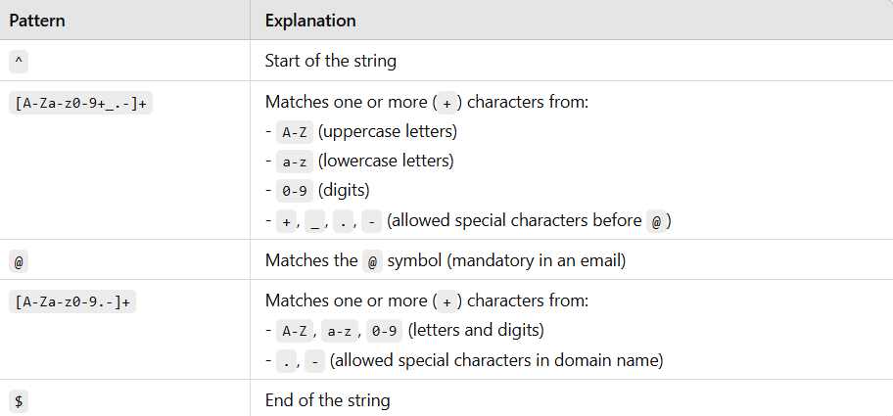
Explanation of the Regex:

Slide 12
Example 6: Extracting All URLs from Text
import java.util.regex.*;
public class URLFinder {
public static void main(String[] args) {
String text = "Visit https://google.com and http://example.com for details.";
Pattern pattern = Pattern.compile("https?://\\S+");
Matcher matcher = pattern.matcher(text);
while (matcher.find()) {
System.out.println("URL found: " + matcher.group());
}
}
}
Explanation:
✔ https?://\\S+ matches URLs starting with http:// or https://. ✔ \\S+ means non-space characters, so the full URL is matched.
Notes:
\sMatches any whitespace character, including space, tab (\t), newline (\n), carriage return (\r), and form feed (\f).
\SMatches any non-whitespace character, meaning it excludes spaces, tabs, newlines, etc.

Slide 13
Example 7: Replacing Text Using Regular Expressions –
import java.util.regex.*;
public class ReplaceText {
public static void main(String[] args) {
String text = "My number is 1234567890";
Pattern pattern = Pattern.compile("\\d"); // Match digits
Matcher matcher = pattern.matcher(text);
String newText = matcher.replaceAll("X"); // Replace all digits
System.out.println("Modified text: " + newText);
}
}
Explanation:
✔ \\d matches each digit individually. ✔ replaceAll("X") replaces all digits with "X".
Notes:
Modified text: My number is XXXXXXXXXX

Slide 14
Example 8: Password Strength Validation
Check if a password is strong (at least 8 characters, includes numbers, uppercase, and special characters).
import java.util.regex.*;
public class PasswordValidation {
public static void main(String[] args) {
String password = "Pass@123";
String regex = "^(?=.*[A-Z])(?=.*[a-z])(?=.*\\d)(?=.*[@$!%*?&])[A-Za-z\\d@$!%*?&]{8,}$";
Pattern pattern = Pattern.compile(regex);
Matcher matcher = pattern.matcher(password);
System.out.println("Strong password: " + matcher.matches());
}
}

Slide 15
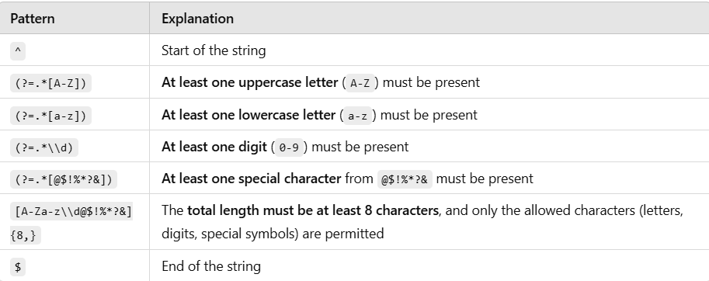
Explanation:
(?= ... ) → This is a positive lookahead, which means "Ensure that the following pattern exists somewhere ahead in the string, but don’t consume characters.
".*X → The .* allows any number of characters (including none) before X, ensuring that X appears anywhere in the string.

Slide 16
Practice questions
Write a Java program to check if a given email address is valid. ✔ A valid email should have the format: username@domain.com ✔ Example Valid Emails:
test@example.com
my.email123@domain.co.in ✔ Example Invalid Emails:
@example.com
test@domain
user@.com
Hint: Use Pattern.compile("\\b[A-Za-z0-9._%+-]+@[A-Za-z0-9.-]+\\.[A-Za-z]{2,}\\b")
Notes:
\\b at both end ensure that you are matching the entire world, not the substing in a world.

Slide 17
Extract All Numbers from a String
Write a Java program to extract and print all numbers (digits) from a given string.
✔ Example Input: "My phone number is 9876543210 and my PIN is 110092" ✔ Expected Output: 9876543210, 110092
Hint: Use Pattern.compile("\\d+")

Slide 18
Validate Mobile Number (10 Digits)
Write a program to check if a given mobile number is valid. ✔ It should be exactly 10 digits long. ✔ Example Valid Numbers:
9876543210
9998887776 ✔ Example Invalid Numbers:
98765 (Too short)
98765432109 (Too long)
abcd123456 (Contains non-numeric characters)
Hint: Use Pattern.compile("\\b\\d{10}\\b")

Slide 19
Check If a String Contains Only Alphabets
Write a Java program to check if a given string contains only alphabets (A-Z, a-z).
✔ Example Inputs and Outputs:
"HelloWorld" → ✅ Valid
"Hello123" → ❌ Invalid
"Java_Regex" → ❌ Invalid
Hint: Use Pattern.compile("^[A-Za-z]+$")

Slide 20
Find Words That Start with a Capital Letter
Write a Java program to extract words that start with an uppercase letter from a sentence.
✔ Example Input: "Rohit and Akash are learning Java in Chitkara University." ✔ Expected Output: "Rohit", "Akash", "Java", "Chitkara", "University"
Hint: Use Pattern.compile("\\b[A-Z][a-z]*\\b")

Slide 21
Find and Replace Multiple Spaces with a Single Space
Write a Java program that replaces multiple spaces in a string with a single space.
✔ Example Input: "Java is fun to learn!" ✔ Expected Output: "Java is fun to learn!"
Hint: Use Pattern.compile("\\s+") and matcher.replaceAll(" ")

Slide 22
Validate a Password (Strong Password Rules)
Write a program to check if a password is strong. ✔ Rules for a strong password:
At least 8 characters long
Contains at least one uppercase letter (A-Z)
Contains at least one lowercase letter (a-z)
Contains at least one digit (0-9)
Contains at least one special character (@, #, $, %, &, etc.)
✔ Example Valid Passwords:
Rohit@123
P@ssw0rd ✔ Example Invalid Passwords:
password ❌ (No digits or special characters)
Pass123 ❌ (Too short)
12345678 ❌ (No letters)
Hint: Use Pattern.compile("^(?=.*[A-Z])(?=.*[a-z])(?=.*\\d)(?=.*[@#$%^&+=]).{8,}$")

Slide 23
Validate Indian Vehicle Number Plate
Write a program to validate an Indian vehicle number plate using regex.
✔ Format: "XX00YY0000"
XX → Two uppercase letters (State Code)
00 → Two digits (District Code)
YY → One or two uppercase letters (Series)
0000 → Four digits (Number)
✔ Example Valid Plates:
PB10AK1234
HR26DA9898 ✔ Example Invalid Plates:
P10AK1234 ❌ (First part must be 2 letters)
PB10A1234 ❌ (Series must be 2 letters)
PB101234 ❌ (Missing letters in series)
Hint: Use Pattern.compile("^[A-Z]{2}\\d{2}[A-Z]{1,2}\\d{4}$")

Slide 24
Validate Date Format (DD/MM/YYYY or DD-MM-YYYY)
Write a program to check if a given date follows the format: DD/MM/YYYY or DD-MM-YYYY.
✔ Example Valid Dates:
12/02/2024
01-01-2023 ✔ Example Invalid Dates:
2023/12/01 ❌ (Year first, incorrect)
31-04-2022 ❌ (April has only 30 days)
Hint: Use Pattern.compile("^(0[1-9]|[12][0-9]|3[01])[-/](0[1-9]|1[0-2])[-/](\\d{4})$")

